Slide 1
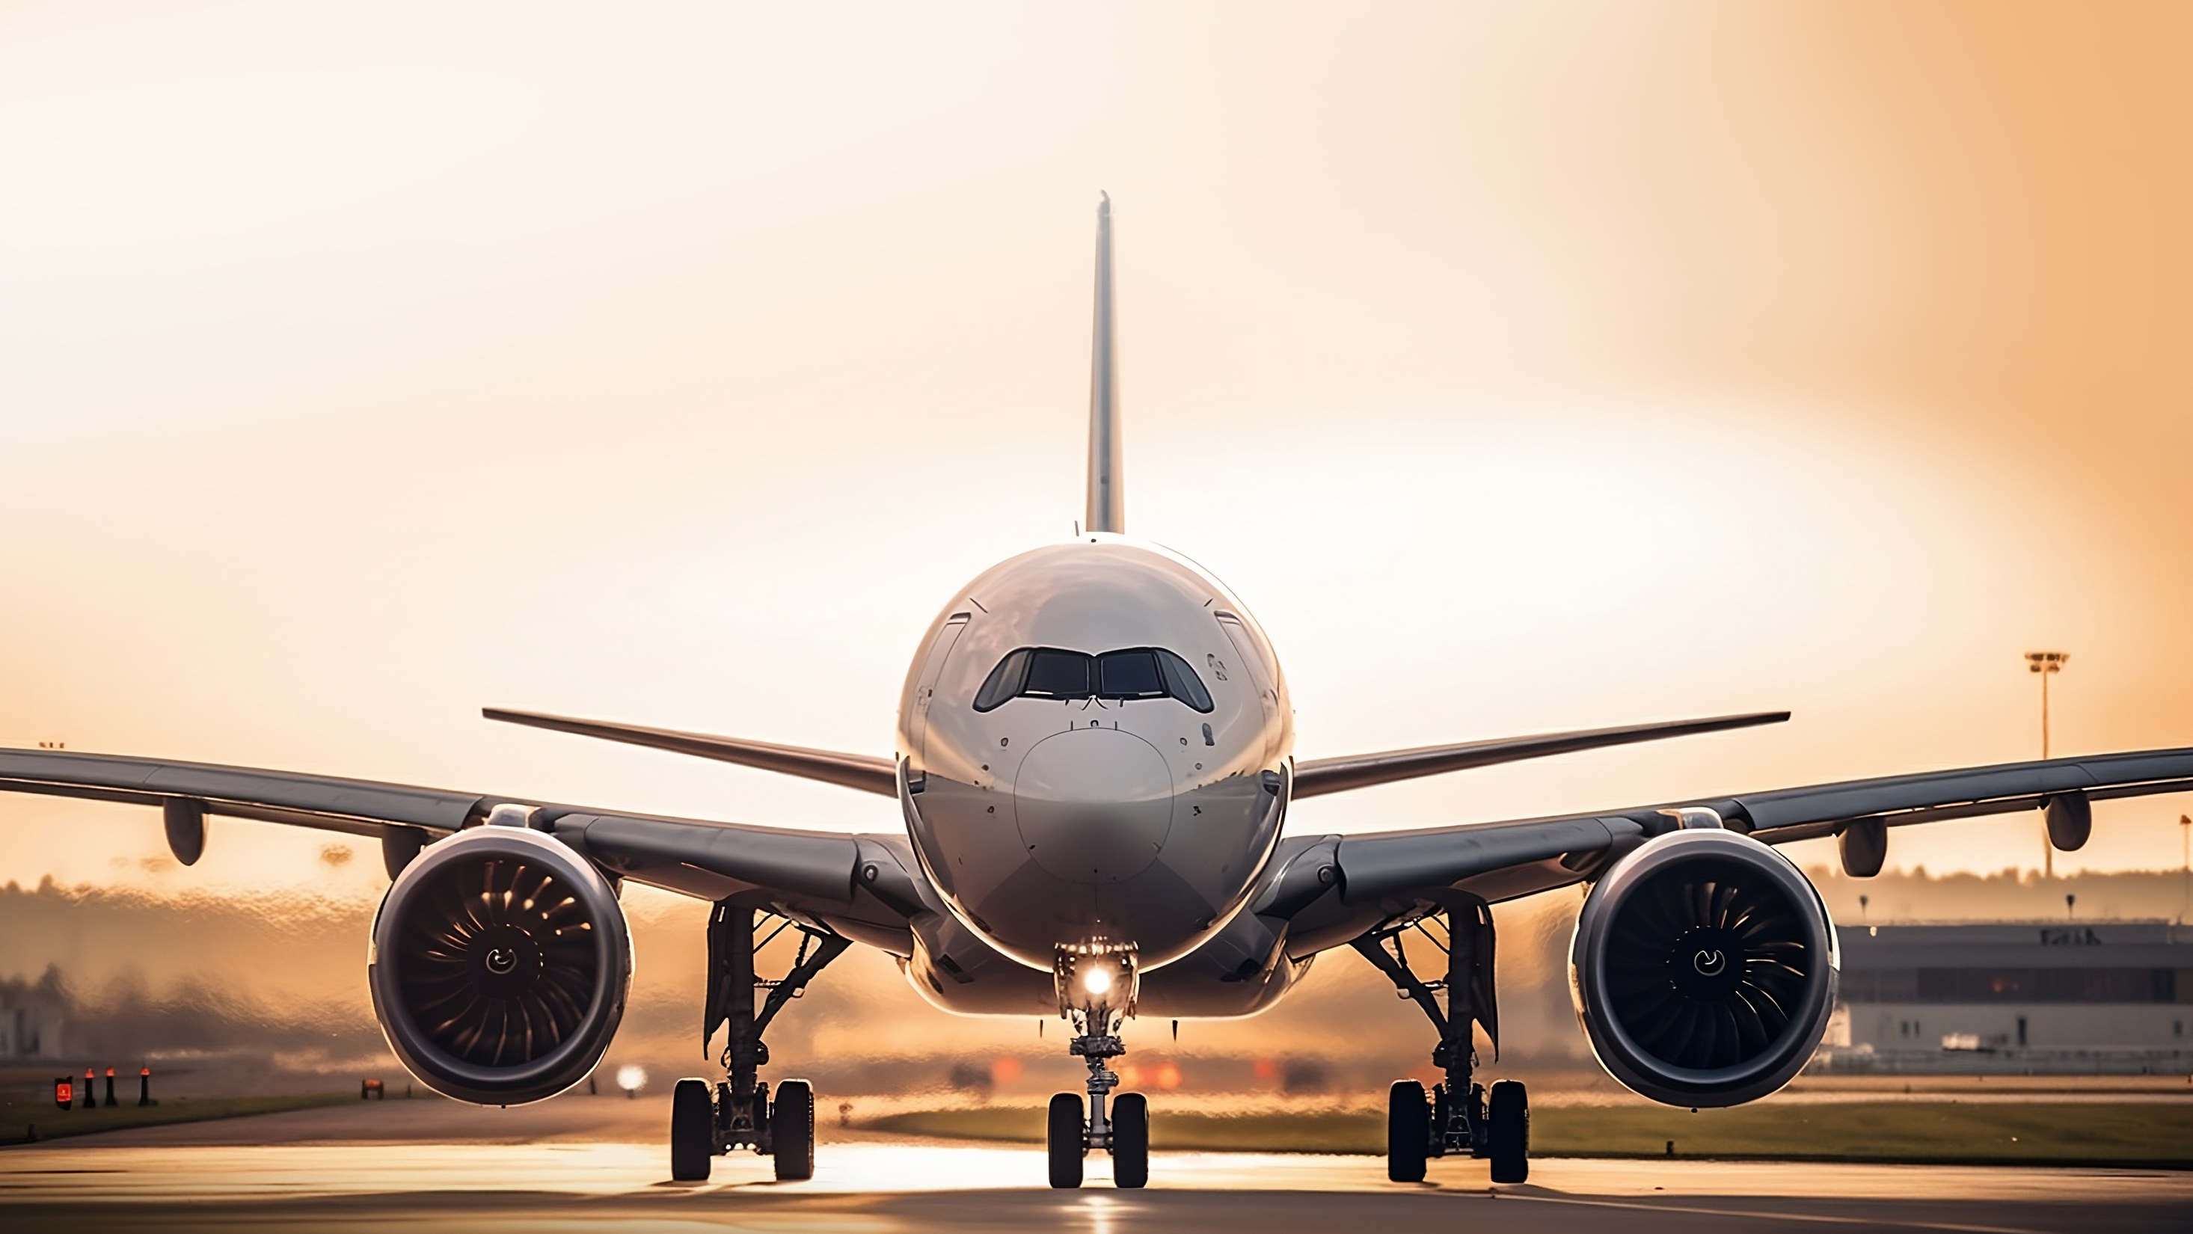

Instructor Resources
Chapter 8 Figures
Cover photo: BeautyStock – stock.adobe.com.

Slide 2
Chapter 8
Normal Procedures

Slide 3
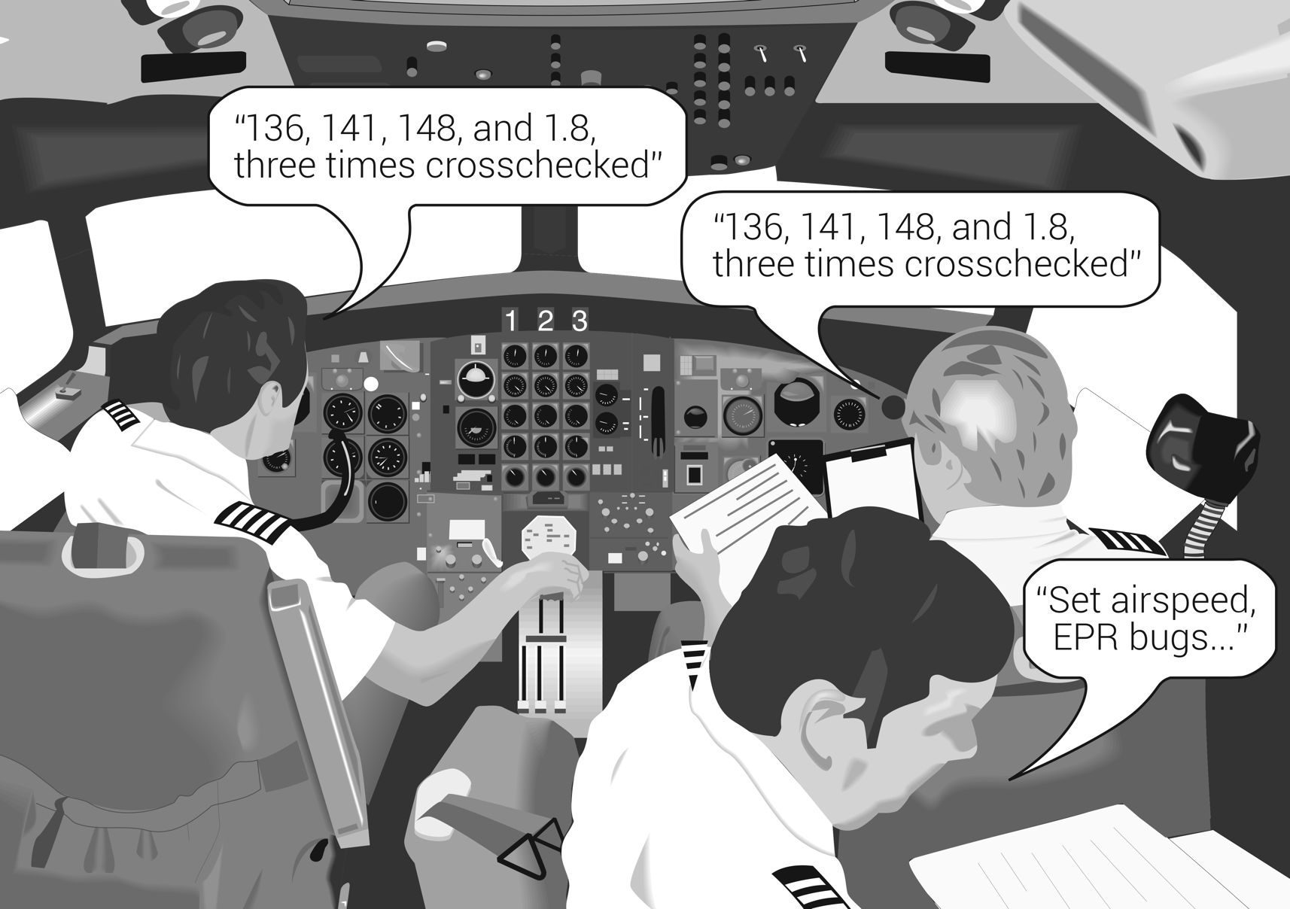
In a three-pilot flight deck, the flight engineer reads the checklist, and the pilot flying and pilot monitoring respond accordingly.
FIGURE 8.1
Crew coordination in a multipilot flight deck.

Slide 4
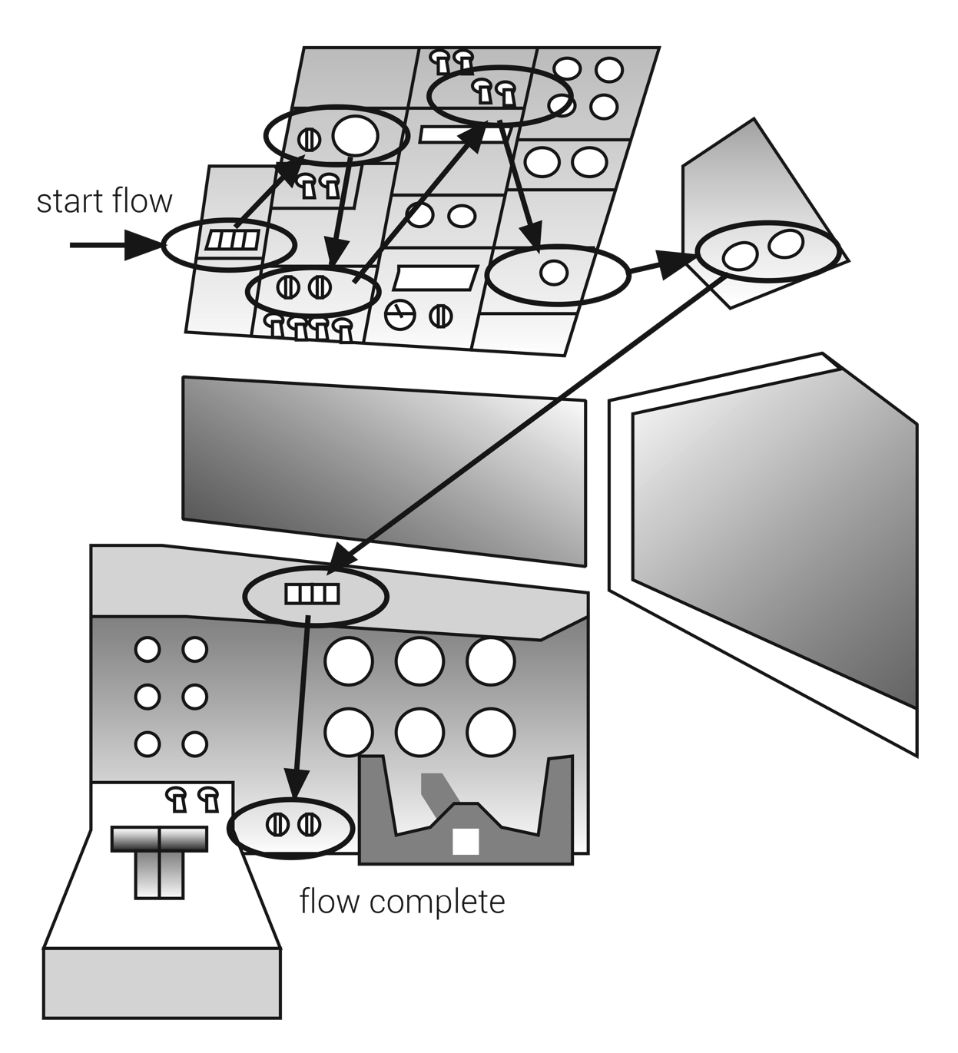
FIGURE 8.2
Flight deck flow check.

Slide 5
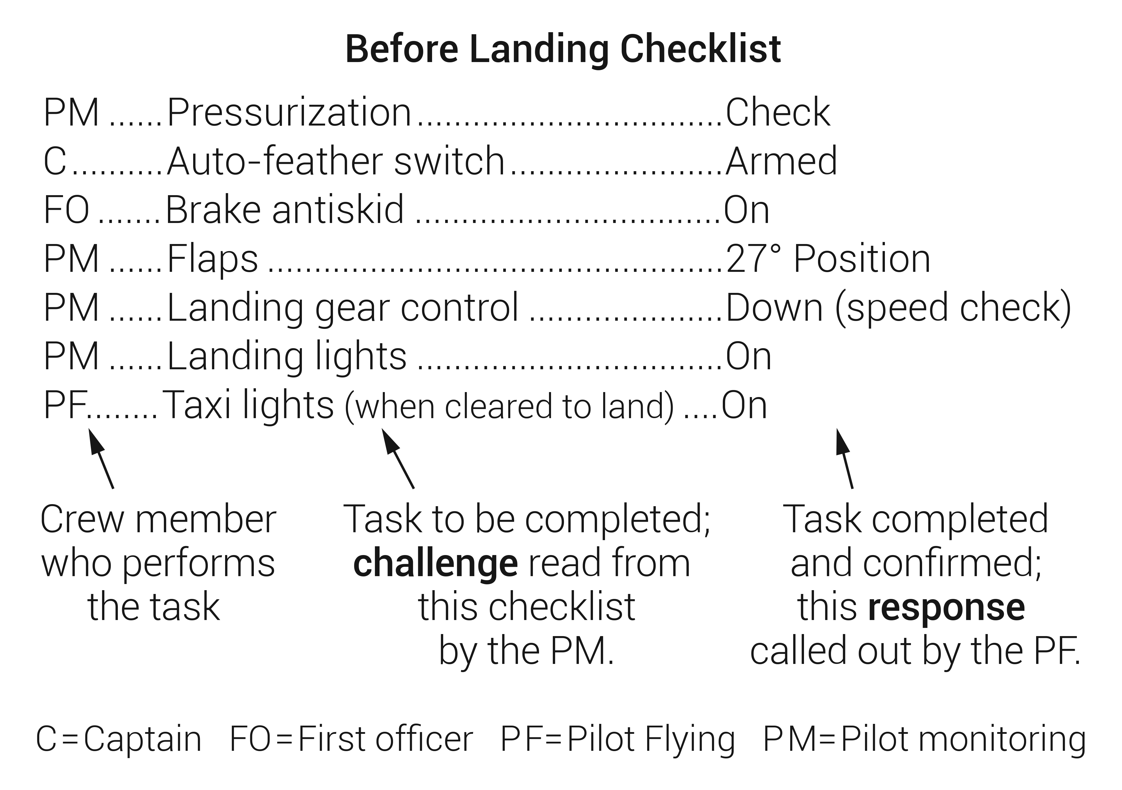
FIGURE 8.3
Challenge-response checklist for a turboprop aircraft.

Slide 6
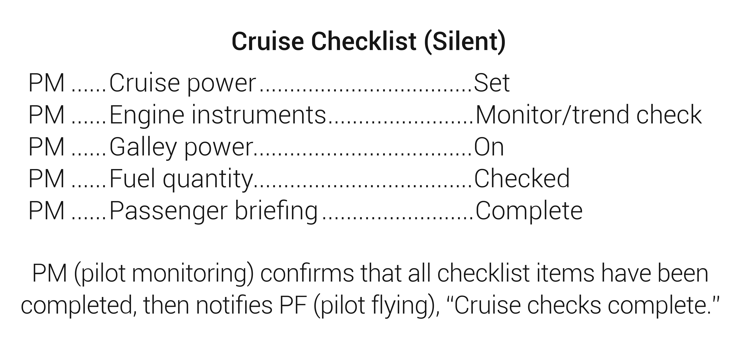
FIGURE 8.4
Do-list checklist.

Slide 7
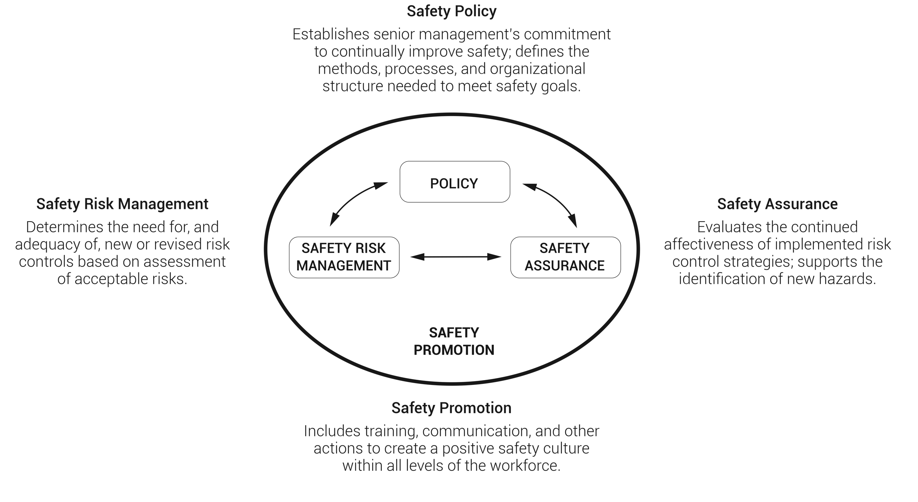
The Four Safety Management System (SMS) Components
FIGURE 8.5
The four Safety Management System (SMS) components.

